Slide 1
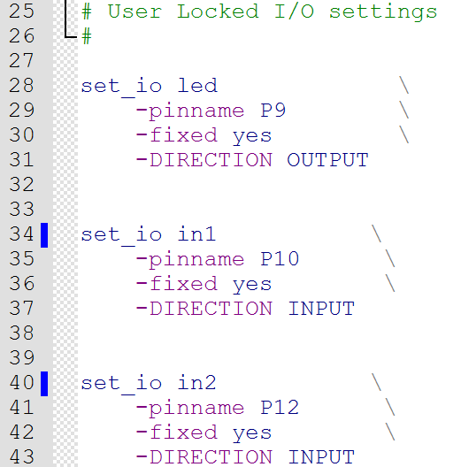
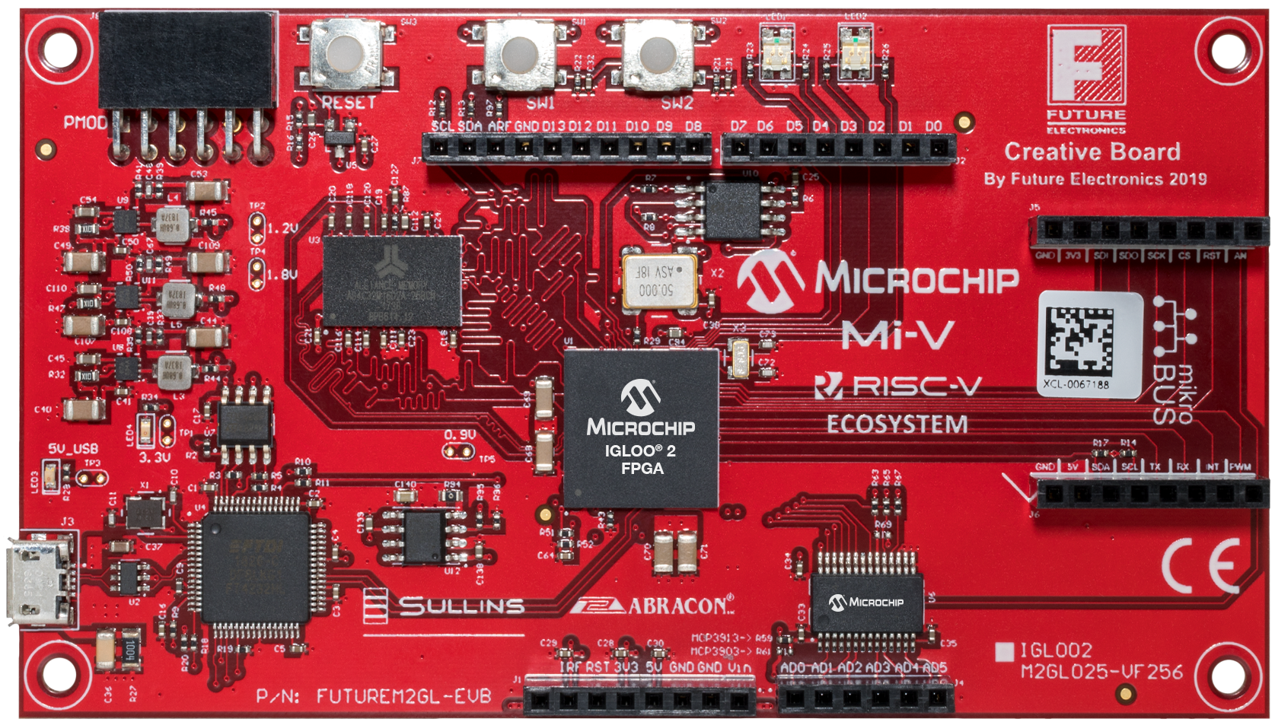
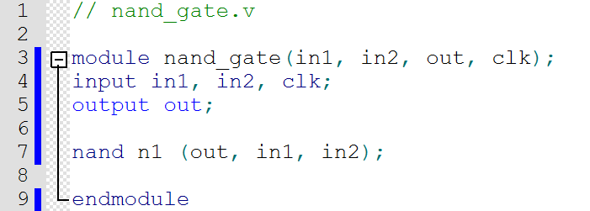
J7
Name | SCL | SDA | ARF | GND | D13 | D12 | D11 | D10 | D9 | D8
FPGA | T6 | T9 | - | - | P13 | P12 | P10 | N10 | M10 | M9
Connector Name | MSIO120NB4/ CCC_SW0_CLKI2 | MSIO130PB4 VCCC_SE0_CLKI | 3.3V | - | MSIO143NB4 | MSIO143PB4 | MSIO133PB4/ BG15/ VCCC_SE1_CLKI | MSIO133NB4 | MSIO132NB4 | MSIO132PB4
J2
Name | D7 | D6 | D5 | D4 | D3 | D2 | D1 | D0
FPGA Pin | P9 | N8 | M8 | P8 | M7 | N7 | P7 | P6
Connector Name | MSIO131PB4/ GB11/ VCCC_SE0_CLK1 | MSIO129PB4/ CCC_SW1_CLKI3 | MSIO129NB4 | MSIO126NB4 | MSIO131PB4/ GB11/ VCCC_SE0_CLK1 | MSIO131PB4/ GB11/ VCCC_SE0_CLK1 | MSIO121NB4/ PROBE_B | MSIO121PB4/ PROBE_A
J8 (PMOD)
Name | FPGA | Connector Name
D0_P | L11 | MSIO3PB2
D0_N | L12 | MSIO3NB2
D1_P | L14 | MSIO2PB2
D1-N | L13 | MSIO2NB2
D2_P | N14 | MSIO1PB2
D2-N | M13 | MSIO1NB2
D3_P | M15 | MSIO0PB2
D3-N | N15 | MSIO0NB2
GND | - | -
GND | - | -
3.3V | - | -
3.3V | - | -
User Buttons
Name | SW1 | SW2
FPGA | H12 | H13
Connector Name | MSIO27NB1 | MSIO28NB1
LEDs
Name | LED1_GREEN | LED1_RED | LED2_GREEN | LED2_RED
FPGA | J16 | K16 | M16 | N16
Connector Name | MSIO11PB2/ CCC_NE0_CLKI0 | MSIO4PB2 | MSIO1NB2 | MSIO1PB2
J5
Name | FPGA | Connector Name
GND | - | -
3.3V | - | -
SDI | R13 | MSIO145NB4
SDO | T13 | MSIO145PB4
SCK | R12 | MSIO138NB4
CS | T12 | MSIO138PB4
RST | R11 | MSIO134NB4
AN | U6(2) | A/D Converter MCP3903-E/ SS CH0
RESET
J6
Name | FPGA | Connector Name
GND | - | -
5V | - | -
SDA | R6 | MSIO120PB4
SCL | T7 | MSIO122PB4
TX | T8 | MSIO122NB4
RX | R8 | MSIO126PB4
INT | R9 | MSIO130NB4
PWM | R10 | MSIO131NB4
J1
Name | - | IRF | RST | 3.3V | 5V | GND | GND | Vin
FPGA | - | - | G1 | - | - | - | - | -
Connector Name | - | - | MSIO07PB7/ GB2/ CCC_NW0_CLKI1 | IOREF | - | - | - | Vin
J4
Name | AD0 | AD1 | AD2 | AD3 | AD4 | AD5
FPGA | U6(2) | U6(5) | U6(6) | U6(9) | U6(10) | U6(13)
Connector Name | A/D Converter MCP3903/ SS CH0 | A/D Converter MCP3903/ SS CH1 | A/D Converter MCP3903/ SS CH2 | A/D Converter MCP3903/ SS CH3 | A/D Converter MCP3903/ SS CH4 | A/D Converter MCP3903/ SS CH5

